Slide 1


#1 EDA & Classification
by Saturdays.AI
Saturdays.AI
Machine Learning

Slide 2

Week 1
Schedule
State of the course
Session 1 Review
Challenge
Notebook + resources

Slide 3
State of the course
#1 Exploratory Data Analysis & Classification 🔴 Today!
#2 Regression & Model Validation 🔜
#3 Random Forest Deep Dive 🔜
#4 Unsupervised Learning 🔜
#5 Neural Networks, Gradient Descent 🔜
#6 NLP 🔜

Slide 4
Exploratory Data Analysis & Classification
Numerical & Visual EDA
Decision Trees
Measure Model Performance
Data Preprocessing
Basics ML models

Slide 5
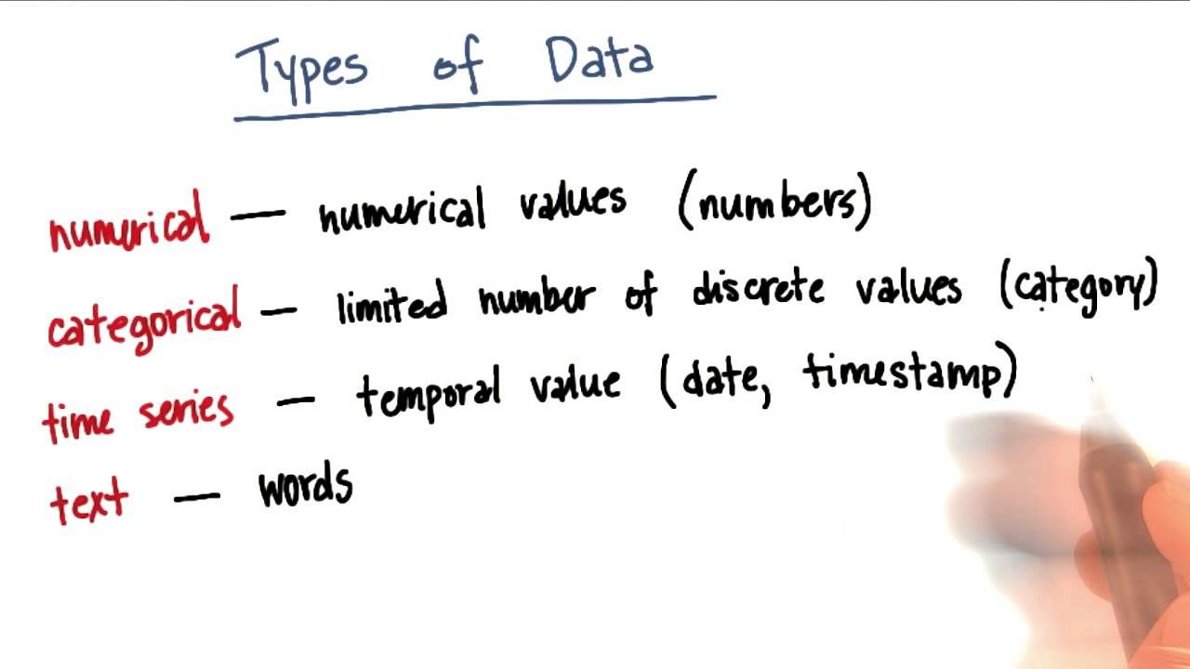
ML: Data types

Slide 6
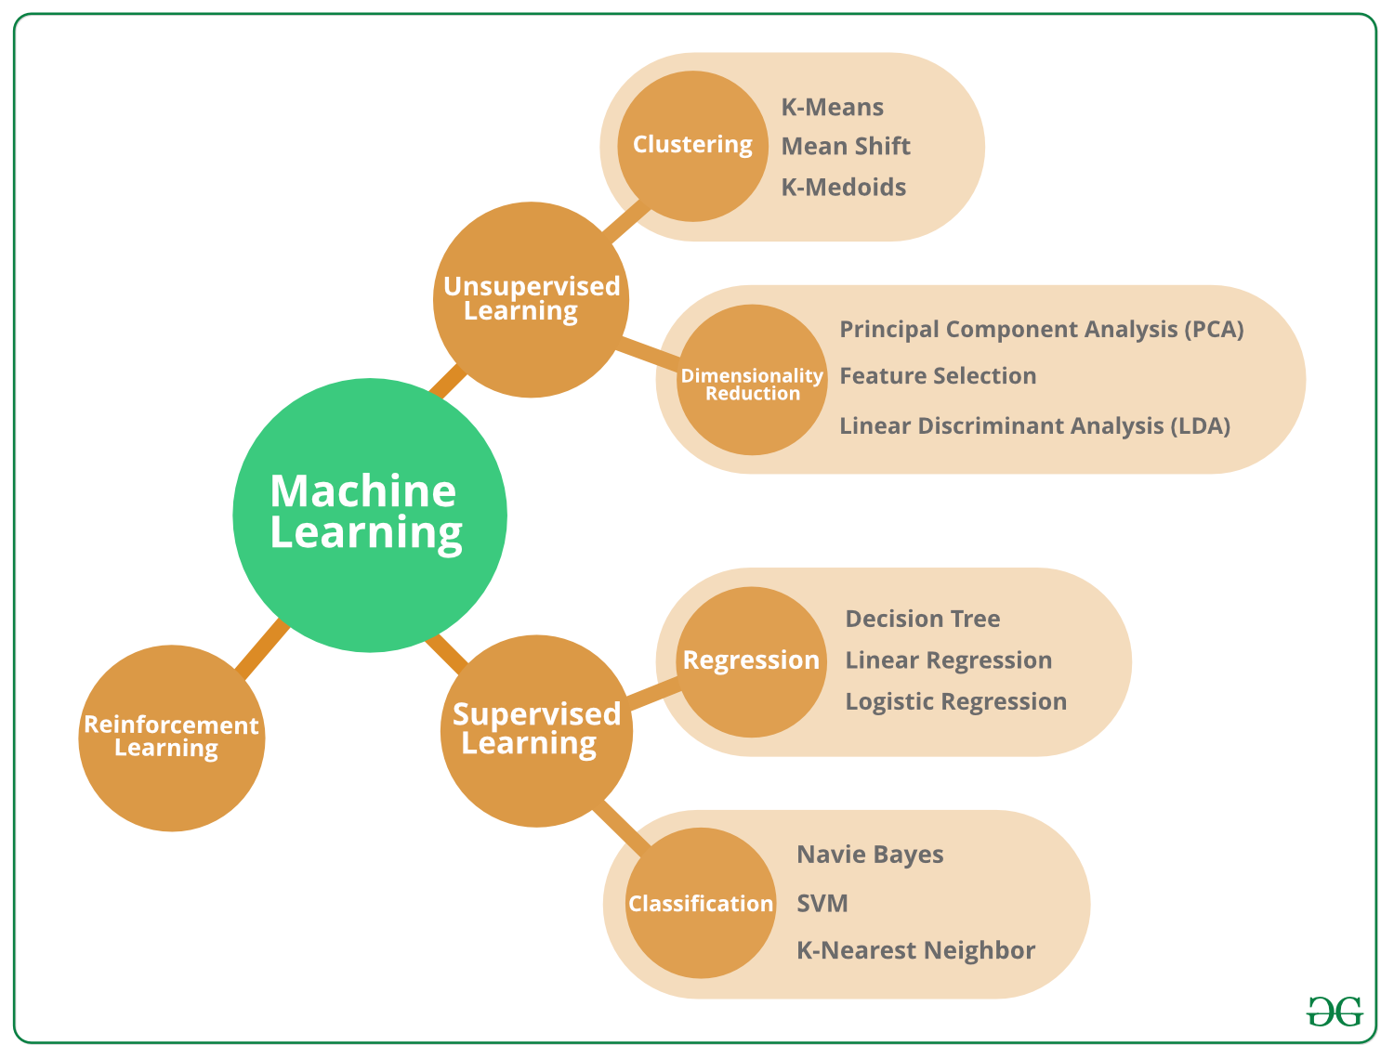
ML: Types of Learning

Slide 7
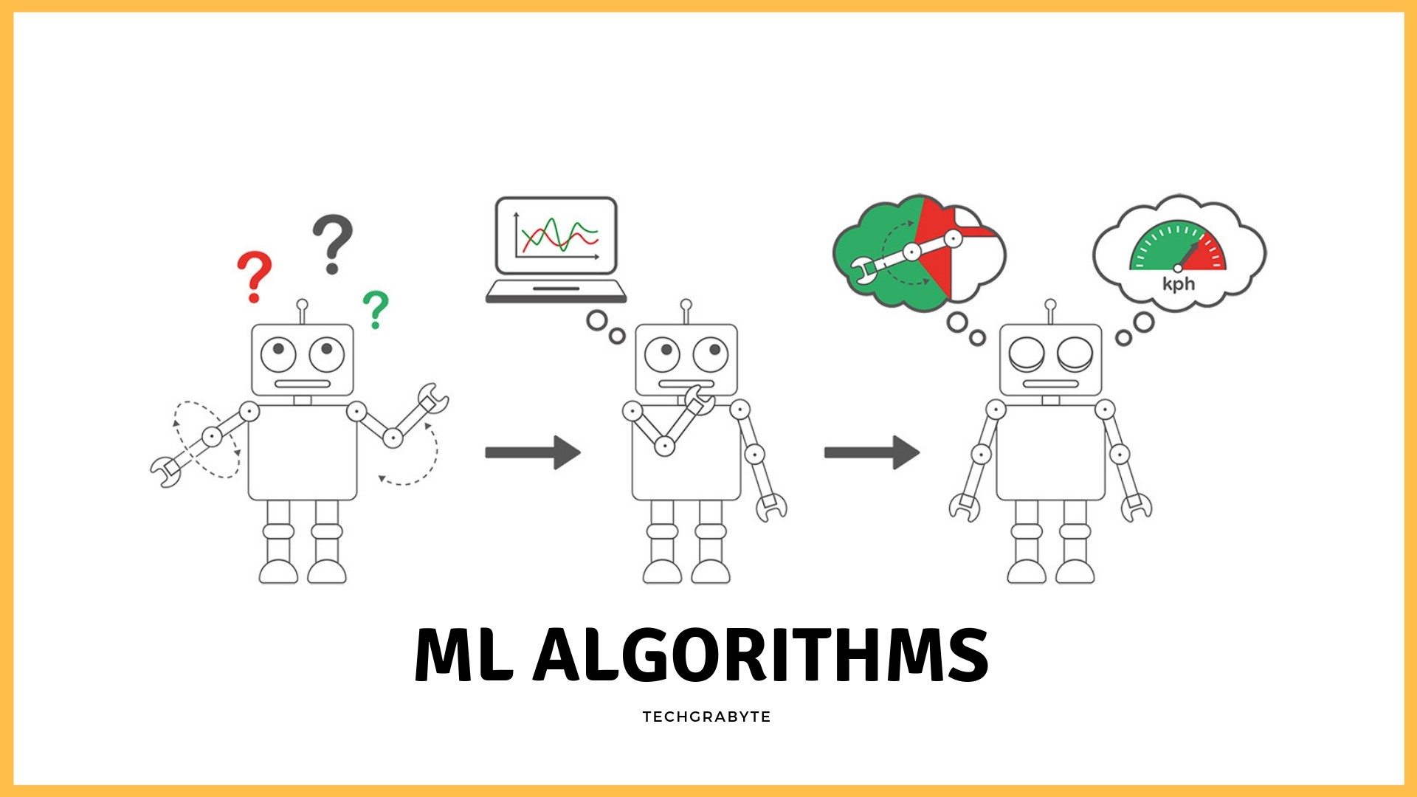
ML: Algorithm architecture types

Slide 8
ML is interdisciplinary
Data
Domain
Knowledge
Insight
Action
Machine learning is …
Computer science + statistics + mathematics
The use of data to answer questions
Critical thinking combined with technical toolkit
Source: deltanalytics.org

Slide 9
ML help us answer questions
How do we define the question?
Before we even get to the models/algorithms, we have to learn about our data and define our research question.
Research
question
Data
validation +
cleaning
Exploratory
analysis
Modeling
phase
Performance
~80% of your time as
a data scientist is spent here,
preparing your data for analysis
Machine learning takes
place during the
modeling phase.
Source: deltanalytics.org

Slide 10

Research question
Examples of research questions:
● Does this patient have malaria?
● Can we monitor illegal deforestation by detecting chainsaw noises in audio streamed from rainforests?
Source: deltanalytics.org

Slide 11
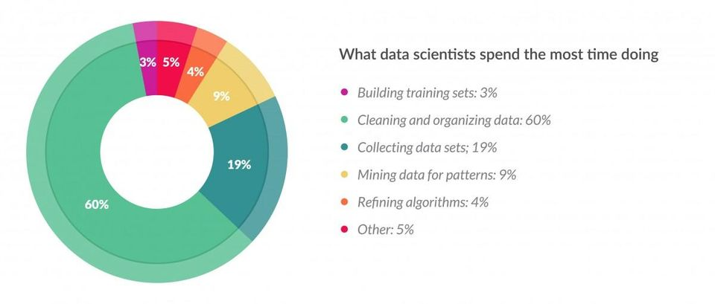
Data Validation and Cleaning
“Data preparation accounts for about 80% of the work of data scientists.”
Source: Survey of 80 data scientists. Forbes article, March 23, 2016.

Slide 12





Data Cleaning
Why do we need to validate and clean our data?
Data often comes from multiple sources
- Do data align across different
sources?
Data is created by humans
- Does the data need to be transformed?
- Is it free from human bias and errors?
Source: deltanalytics.org

Slide 13
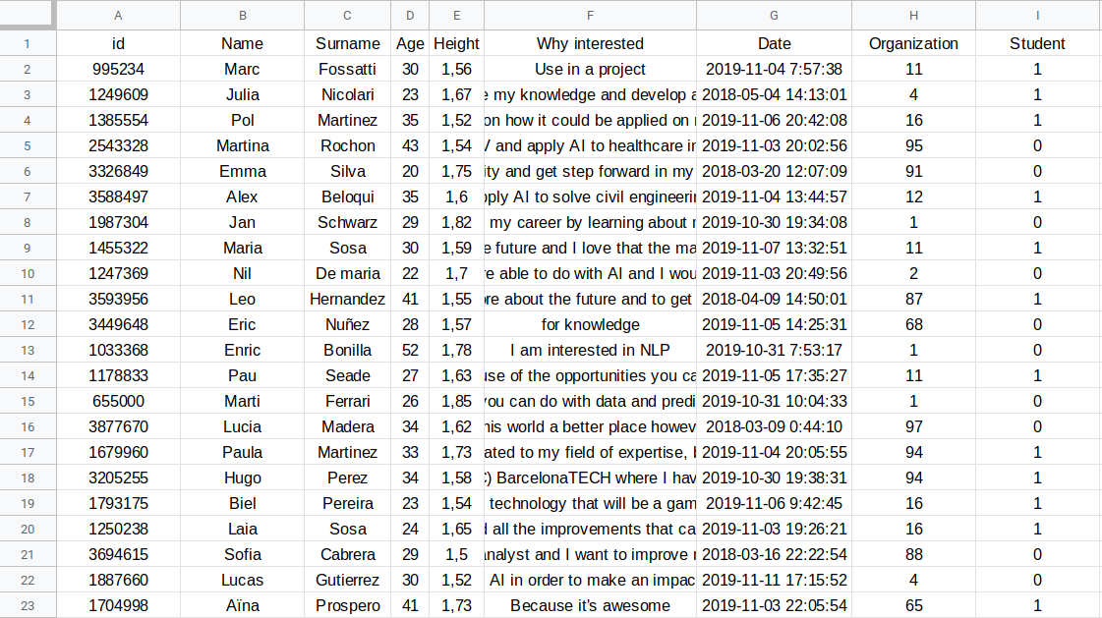
Data Cleaning
spreadsheet = dataset
1 column = 1 attribute
target variable
1 row = 1 observation
training data

Slide 14




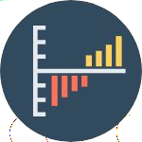

Data Cleaning
Data cleaning involves identifying any issues with our data and confirming our
qualitative understanding of the data.
Missing Data
Is there missing data? Is it
missing systematically?
Data Type
Are all variables the right type?
Is a date treated like a date?
Times Series Validation
Is the data for the correct
time range?
Are there unusual spikes in
the volume of loans over
time?
Data Range
Are all values in the
expected range?
Are all loan_amounts greater than 0?
Source: deltanalytics.org

Slide 15




Data Cleaning
Let’s step through some examples:
Data
cleaning
Missing data
Time series
Data types
After gaining an initial
understanding of your data, you
may need to transform it to be
used in analysis
Transforming
variables
Source: deltanalytics.org

Slide 16

Data Cleaning: Missing data
Missing completely at random:
no pattern in the missing data.
This is the best type
of missing you can hope for.
Very few datasets
have no missing data;
most of the time you
will have to deal with
missing data.
The first question you
have to ask is what
type of missing data
you have.
Missing at random:
there is a pattern in your missing data but not in your variables of interest.
Missing not at random:
there is a pattern in the missing data
that systematically affects your
primary variables.
Source: deltanalytics.org

Slide 17
Data Cleaning: Missing data
Drop missing observations
Populate missing values with average of available data
● Impute data: Educated Guessing
Average Imputation
Common-Point Imputation
Regression Substitution
Multiple Imputation
What you should do depends heavily on what makes sense for your research question, and your data.
Lecture: 7 Ways to Handle Missing Data
Sometimes, you can replace missing data.
Source: deltanalytics.org

Slide 18
Data Cleaning: Time series
If we have observations over time, we need to do time series validation.
Ask yourself:
Is the data for the correct time range?
Are there unusual spikes in the data over time?
What should we do if there are unusual spikes in the data over time?
Source: deltanalytics.org

Slide 19


Data Cleaning: Time series
How do we address unexpected spikes in our data?
For certain datasets, (like sales data) systematic seasonal spikes are expected. For example, around Christmas we would see a spike in sales venue. This is normal, and should not necessarily be removed.
Systematic
spike
Data
anomaly
If the spike is isolated it is probably unexpected, we may want to remove the corrupted data.
For example, if for one month sales are recorded in £ rather than €, it would corrupt the sales figures. We should do some data cleaning by converting to € or perhaps remove this month.
Random
spike
Source: deltanalytics.org
Notes:
Sometimes there are natural anomalies in data that should be investigated first

Slide 20
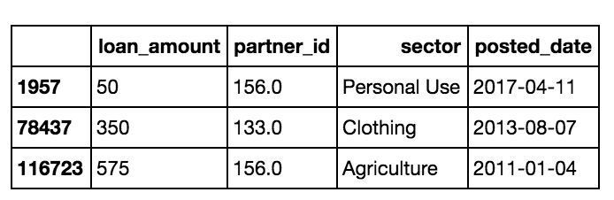
Data Cleaning: Data types
Are all variables the right type?
Many functions in Python are type specific, which means we need to make sure all of our fields are being treated as the correct type:
integer
float
string
date
Lecture: Datacarpentry - Data types & formats
Source: deltanalytics.org

Slide 21
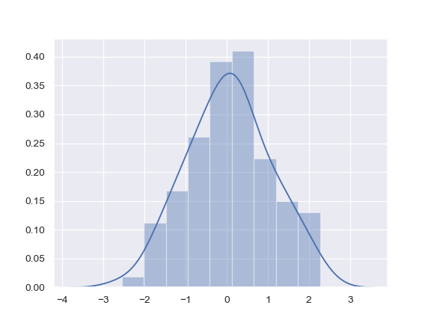
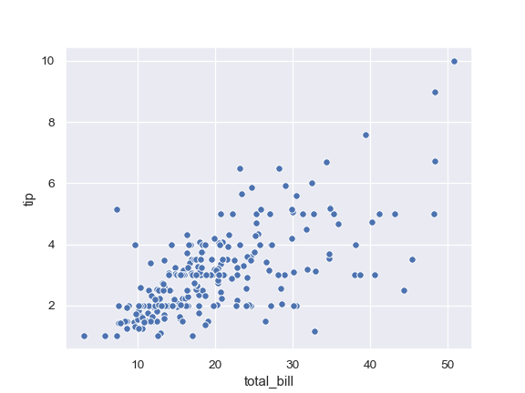
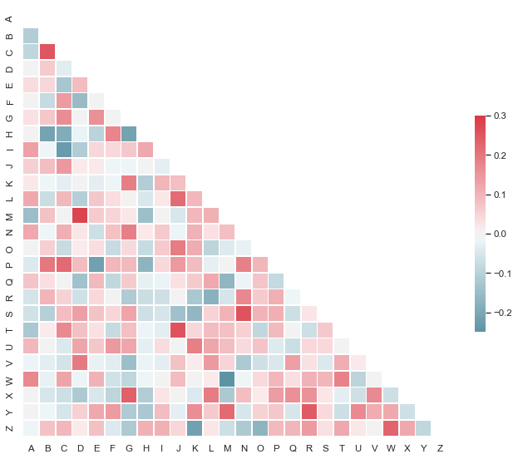
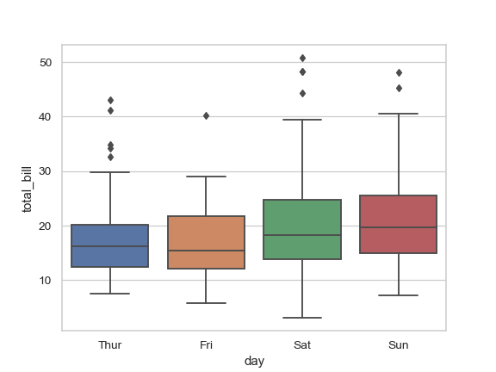
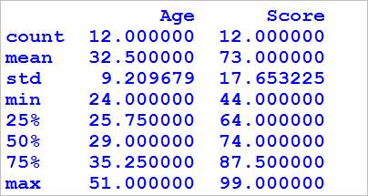
Exploratory analysis
The goal of exploratory analysis is to better understand your data.
Exploratory
analysis
Histogram
Scatterplots
Exploratory analysis can reveal
data limitations, what features
are important, and inform what
methods you use in answering
your research question.
Correlation
Box plots
Summary
statistics
Source: deltanalytics.org

Slide 22
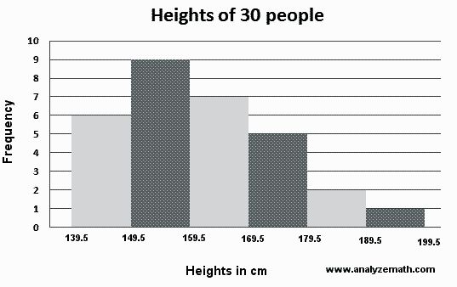
Exploratory analysis: Histogram
Histograms tell us about the distribution of the feature.
A histogram shows the
frequency distribution of a
continuous feature.
Here, we have height data of a
group of people. We see that
most of the people in the
group are between 149 and
159 cm tall.
Lecture: University of Florida, Histograms & Stemplots
Source: deltanalytics.org

Slide 23
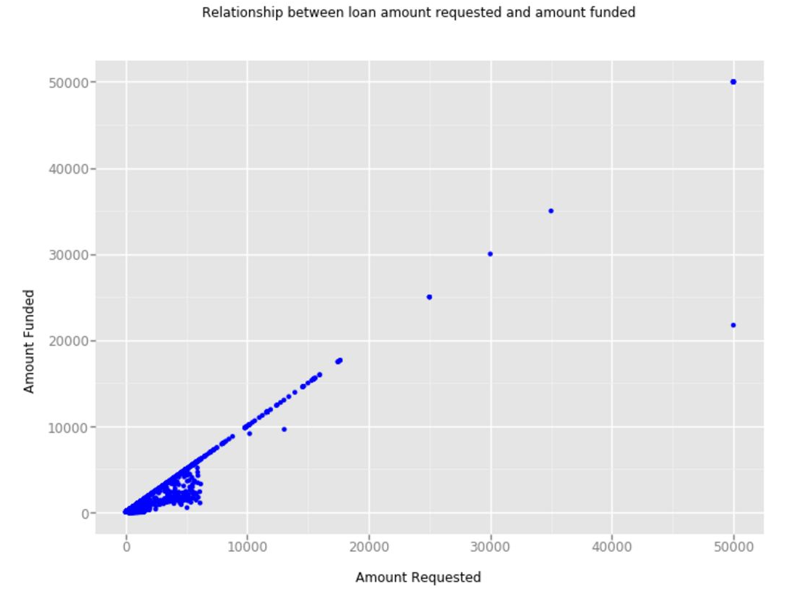
Exploratory analysis: Scatterplot
Scatter plots provide insight about the relationship between two features.
Scatter plots visualize
relationships between any two
features as points on a graph.
They are a useful first step to
exploring a research question.
Here, we can already see a positive
relationship between amount
funded and amount requested.
What can we conclude?
Lecture: University of Florida, Scatterplots
Source: deltanalytics.org
Notes:
It looks like there is a strong relationship between what loan amount is requested and what is funded.

Slide 24
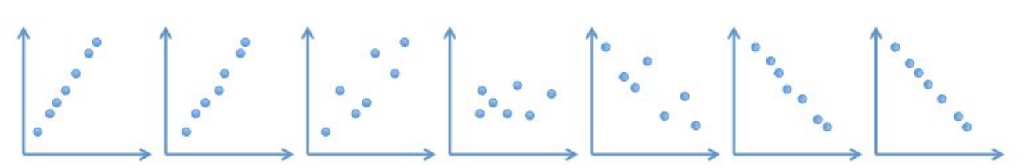
Exploratory analysis: Correlation
Correlation is a useful measure of the strength of a relationship between two variables. It ranges from -1.00 to 1.00
Perfect positive
correlation
High positive
correlation
Low positive
correlation
No
correlation
Low negative
correlation
High negative
correlation
Perfect negative
correlation
1.00
0.88
0.60
0.00
-0.55
-0.78
-1.00
Go further with this fun game.
Source: deltanalytics.org
Notes:
It looks like there is a strong relationship between what loan amount is requested and what is funded.

Slide 25
Exploratory analysis: Correlation
Correlation does not equal causation
Correlation: 0.96
If you wanted to be funded, and were presented with this graph only,
you might conclude that it is a
good idea to request 50k €.
But common sense tells us that this conclusion doesn’t make a lot of sense. Just because you request a lot doesn’t mean you will be funded a lot!
Lecture: University of Florida, Causation
Source: deltanalytics.org
Notes:
Autocorrelation of two random variables, review (or two defined variables like two models of data).

Slide 26
Exploratory analysis: Boxplot
Boxplots are a useful visualization of certain summary statistics.
Outside Values
min(max, Q2+1.5*(Q3-Q1)
3rd quartile
50% of data
Median
1st quartile
max(min, Q1-1.5*(Q3-Q1)
Outside Values
Lecture: University of Florida, Boxplot

Slide 27
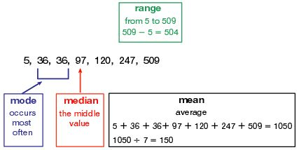
Exploratory analysis: Summary statistics
Mean, median, frequency are useful summary statistics that let you know what is in your data.
Source: deltanalytics.org

Slide 28
Machine learning helps us answer questions
Research
question
Data
validation +
cleaning
Exploratory
analysis
Modeling
phase
Performance
NOW!
Source: deltanalytics.org

Slide 29

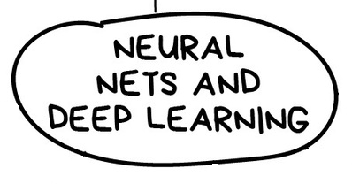
ML Algorithms

Slide 30
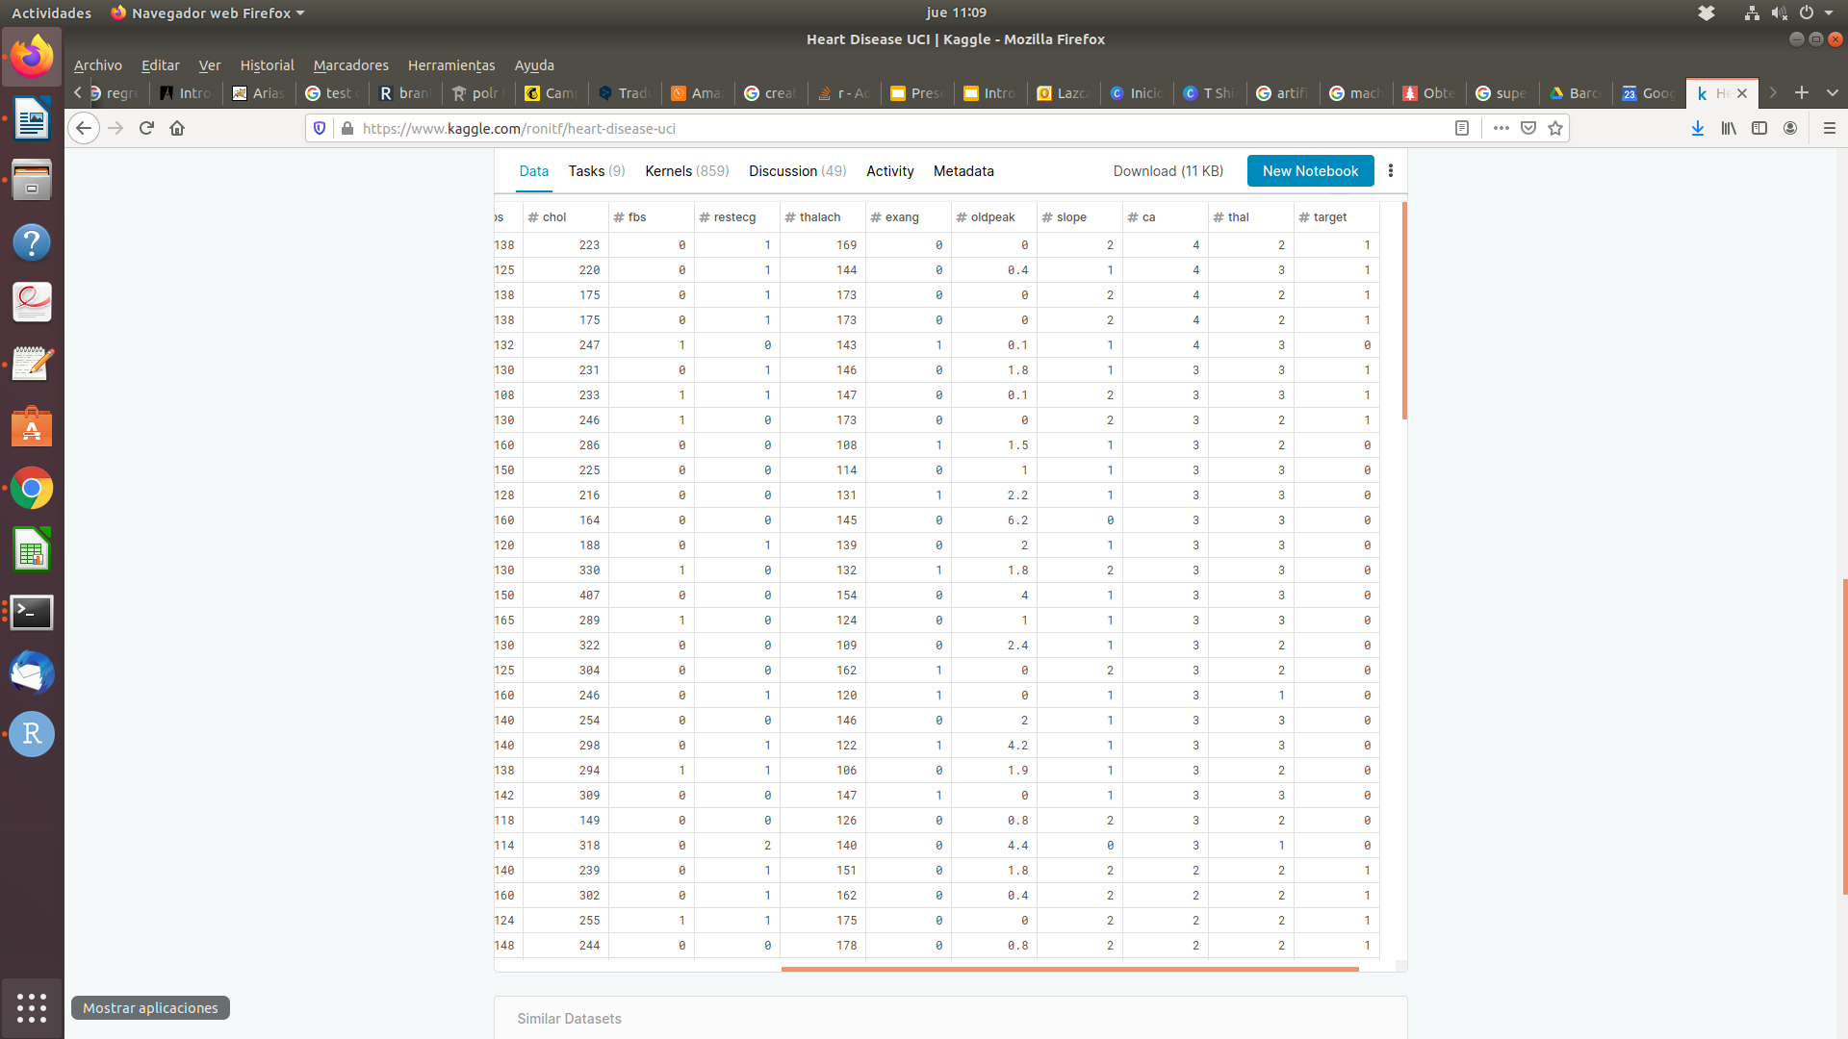
Supervised learning
Basically SUPERVISED LEARNING is used when our data is labelled. This means that we have an output variable for all the input variables.
For example, we have the following dataset:
Notes:
Jan

Slide 31
Supervised learning
The majority of practical machine learning uses supervised learning.
Supervised learning is where you have input variables (x) and an output variable (Y) and you use an algorithm to learn the mapping function from the input to the output.
Y = f(X)
The goal is to approximate the mapping function so well that when you have new input data (x) that you can predict the output variables (Y) for that data.
It is called supervised learning because the process of an algorithm learning from the training dataset can be thought of as a teacher supervising the learning process. We know the correct answers, the algorithm iteratively makes predictions on the training data and is corrected by the teacher. Learning stops when the algorithm achieves an acceptable level of performance.
Notes:
Esta la quito igual

Slide 32
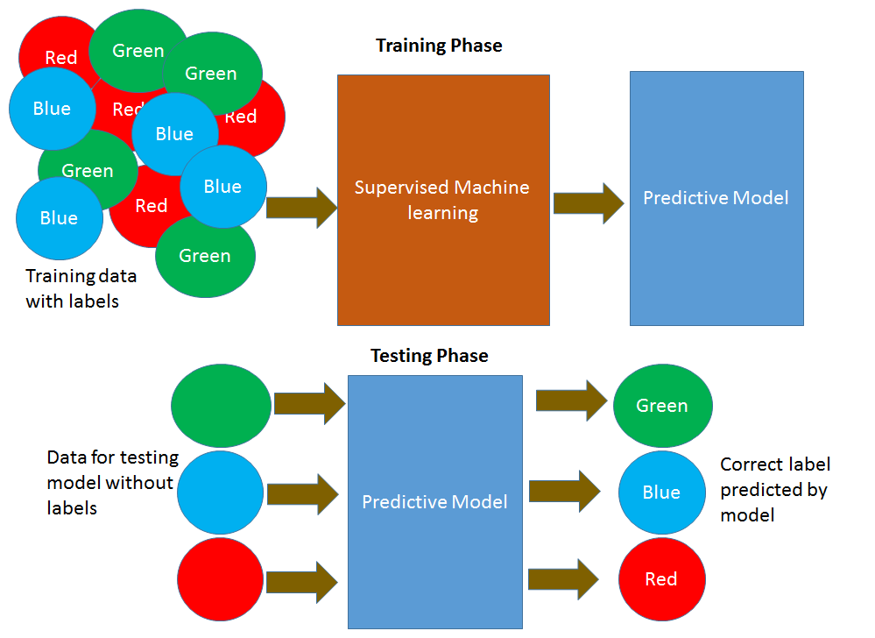
Supervised learning
Notes:
Jan

Slide 33
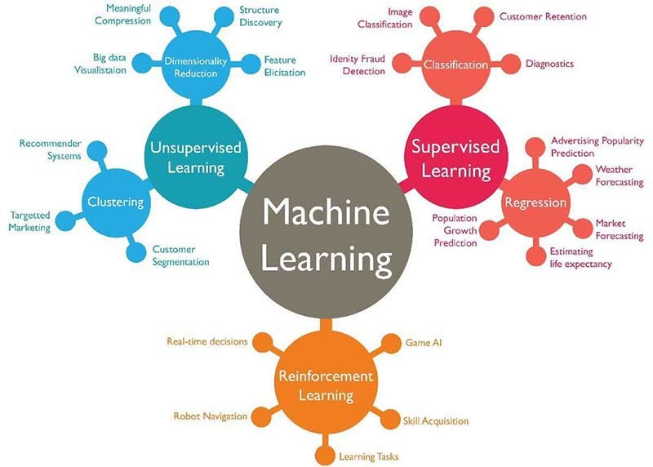
Machine learning
Supervised Learning
Notes:
Jan

Slide 34
Machine learning
Categorical variables Classification problems
Supervised Learning

Slide 35
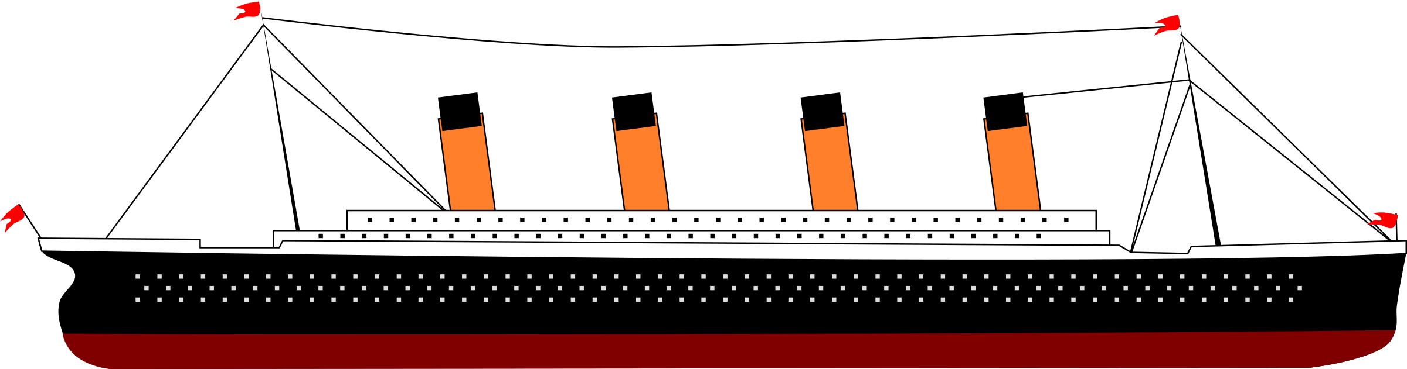
Supervised learning: classification
TITANIC Dataset
PassengerId | Survived | Pclass | Sex | Age | SibSp | Parch | Ticket
1 | 0 | 3 | male | 22 | 1 | 0 | A/5 21171
2 | 1 | 1 | female | 38 | 1 | 0 | PC 17599
3 | 1 | 3 | female | 26 | 0 | 0 | STON/O2. 3101282
4 | 1 | 1 | female | 35 | 1 | 0 | 113803
5 | 0 | 3 | male | 35 | 0 | 0 | 373450
6 | 0 | 3 | male |  | 0 | 0 | 330877
7 | 0 | 1 | male | 54 | 0 | 0 | 17463
8 | 0 | 3 | male | 2 | 3 | 1 | 349909
9 | 1 | 3 | female | 27 | 0 | 2 | 347742
10 | 1 | 2 | female | 14 | 1 | 0 | 237736

Slide 36
Supervised learning: classification
TITANIC Dataset
PassengerId | Survived | Pclass | Sex | Age | SibSp | Parch | Ticket
1 | 0 | 3 | male | 22 | 1 | 0 | A/5 21171
2 | 1 | 1 | female | 38 | 1 | 0 | PC 17599
3 | 1 | 3 | female | 26 | 0 | 0 | STON/O2. 3101282
4 | 1 | 1 | female | 35 | 1 | 0 | 113803
5 | 0 | 3 | male | 35 | 0 | 0 | 373450
6 | 0 | 3 | male |  | 0 | 0 | 330877
7 | 0 | 1 | male | 54 | 0 | 0 | 17463
8 | 0 | 3 | male | 2 | 3 | 1 | 349909
9 | 1 | 3 | female | 27 | 0 | 2 | 347742
10 | 1 | 2 | female | 14 | 1 | 0 | 237736

Slide 37
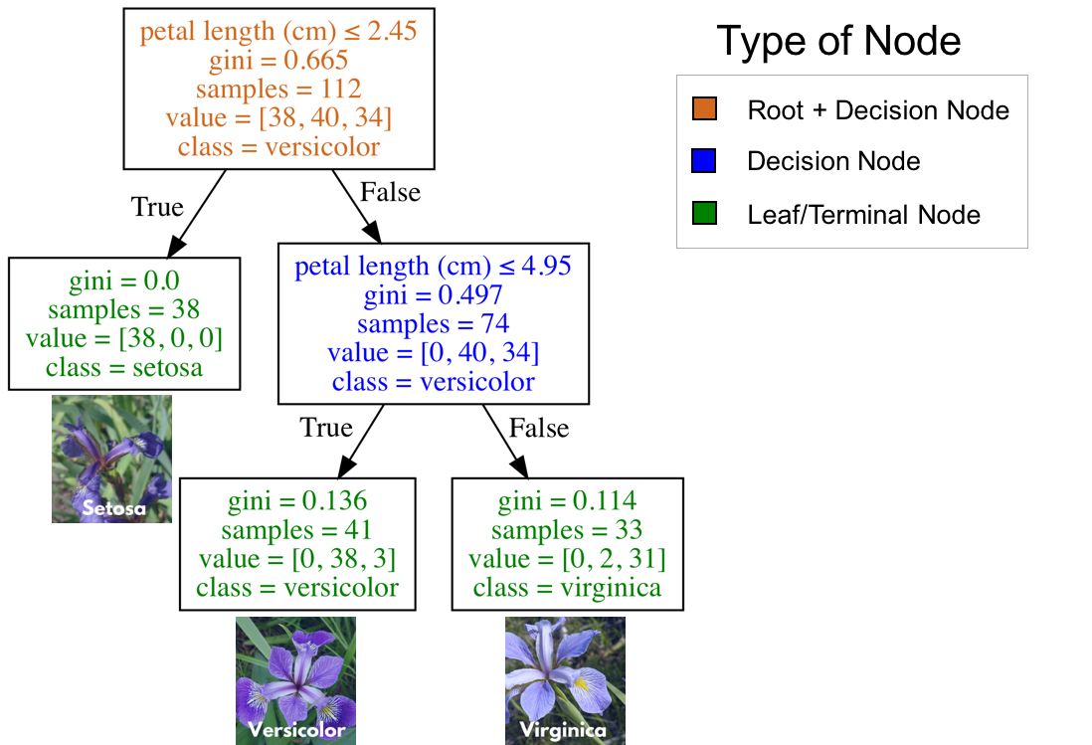
Decision Tree Algorithms
Notes:
Esta la quito igual

Slide 38
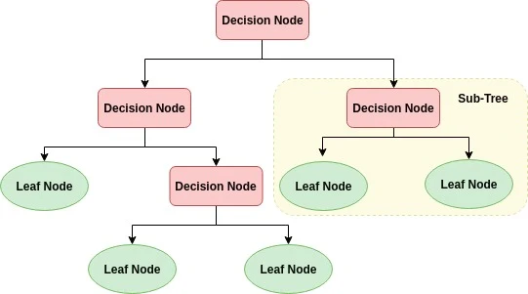
Decision Tree Algorithms
DEPTH OF TREE
Depth =1
Depth =2
Depth =3
Notes:
Esta la quito igual

Slide 39
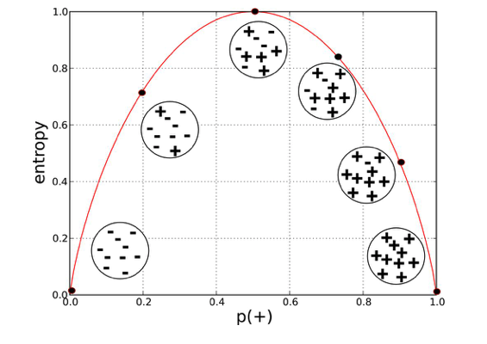
Decision Tree Algorithms
GINI IMPURITY:
The Gini impurity can be computed by summing the probability of an item with label being chosen times the probability of a mistake in categorizing that item. It reaches its minimum (zero) when all cases in the node fall into a single target category.
ENTROPY:
Entropy to calculate the homogeneity (or impurity) of a sample. If the sample is completely homogeneous the entropy is zero and if the sample is an equally divided it has entropy of one.
Further information about gini index: learnbymarketing.com/481/decision-tree-flavors-gini-info-gain
Notes:
Esta la quito igual

Slide 40

Practice - EDA!

Slide 41
Practice - Classification!

Slide 42
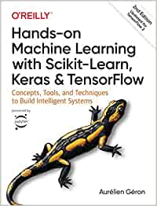


Bibliografía
/1./ /Hands-on Machine Learning with Scikit-Learn, Keras, and TensorFlow/
/2./ /Fast.AI - Introduction to Machine Learning for Coders/
/3./ /MLCourse.AI/
/4./ /DeltaAnalytics/
/5./ /The Hundred-page Machine Learning Book/
/6./ /Machine Learning for Humans (Vishal Maini)/
/7./ /Datacamp/
/8./ /DataQuest/

Slide 43

WI-FI
Wi-Fi
madrid@saturdays.ai

